Slide 1
GestureSpeak AI-Powered Real-Time Sign Language Translation
Guide Details:

Slide 2
Team Members
01
02
03
Manohar Reddy 21BRS1177
Sai Ruthwik Reddy 21BCE5539
Raghava Surya 21BRS1614

Slide 3
Area of Project
This project is centered on the development of an advanced, real-time sign language recognition system, harnessing the power of Convolutional Neural Networks (CNNs) and cutting-edge computer vision techniques.
The system is designed to interpret and translate sign language gestures into textual information in real-time, offering a seamless communication bridge between the deaf and hard-of-hearing community and non-signers.
By integrating robust machine learning algorithms with efficient video processing frameworks, this project pushes the boundaries of accessibility technology, aiming for high accuracy, scalability, and practical usability in diverse real-world environments.

Slide 4
Background of the project
The lack of a universal communication method between sign language users and non-signers creates significant barriers in both social and professional environments.
Current assistive technologies are either cumbersome or lack real-time capabilities, leaving a gap in effective communication solutions. Our project addresses this by integrating advanced machine learning models with real-time video processing, making seamless interaction possible across diverse settings.

Slide 5
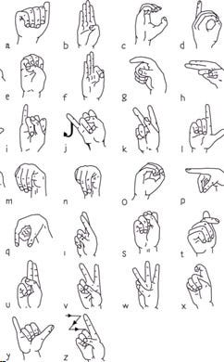
Problem Statement
We aim to develop a highly accurate and real-time sign language recognition system to bridge the communication gap between sign language users and the broader community.
By utilizing CNNs trained on extensive American Sign Language (ASL) datasets, our system will classify and translate gestures into text with high precision.
The system’s architecture is designed for scalability, allowing future extensions to include dual-hand gestures, facial expressions, and more complex sign languages, ensuring that the solution remains robust in diverse real-world scenarios.

Slide 6
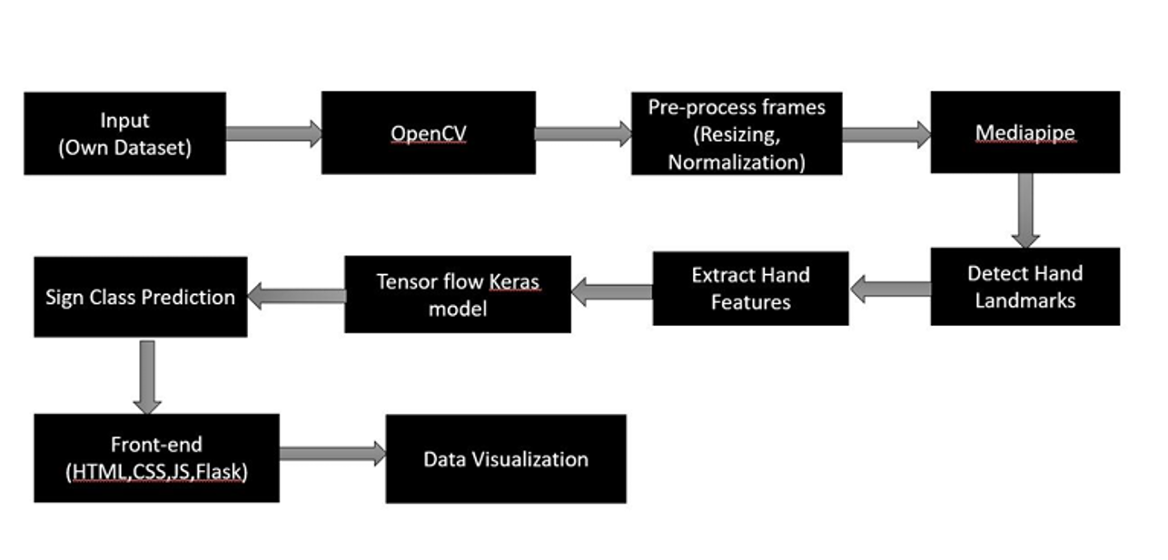
Methodology

Slide 7
Novelty of the
The novelty of this project lies in the development of a real-time sign language recognition system that effectively combines:
Advanced Computer Vision Techniques: Utilizing tensorflow , Keras frame works , a powerful deep learning library, to accurately detect and recognize sign language gestures in real-time. Creating Our own DataSet using OpenCV.
Combined Technological Stack: Effectively integrating computer vision with web development technologies (HTML, CSS, JavaScript, Flask) for a comprehensive system.
Intuitive User Interface: Creating a user-friendly interface using HTML, CSS, React, and Flask to seamlessly display detected signs and corresponding sentences, providing an engaging and accessible experience.

Slide 8
Existing Systems –BASE PAPER
[1] Bantupalli, K. and Xie, Y., 2018, December. American sign language recognition using deep learning and computer vision. In 2018 IEEE International Conference on Big Data (Big Data) (pp. 4896-4899). IEEE.
[2] Vogler, C. and Metaxas, D., 1999, September. Parallel hidden markov models for american sign language recognition. In Proceedings of the seventh IEEE international conference on computer vision (Vol. 1, pp. 116-122). IEEE

Slide 10
Questions

Slide 11
Thank You Sir

